Slide 1

Statistical Fundamentals: Using Microsoft Excel for Univariate and Bivariate Analysis Alfred P. Rovai
Histograms
PowerPoint Prepared by Alfred P. Rovai
Microsoft® Excel® Screen Prints Courtesy of Microsoft Corporation.

Slide 2
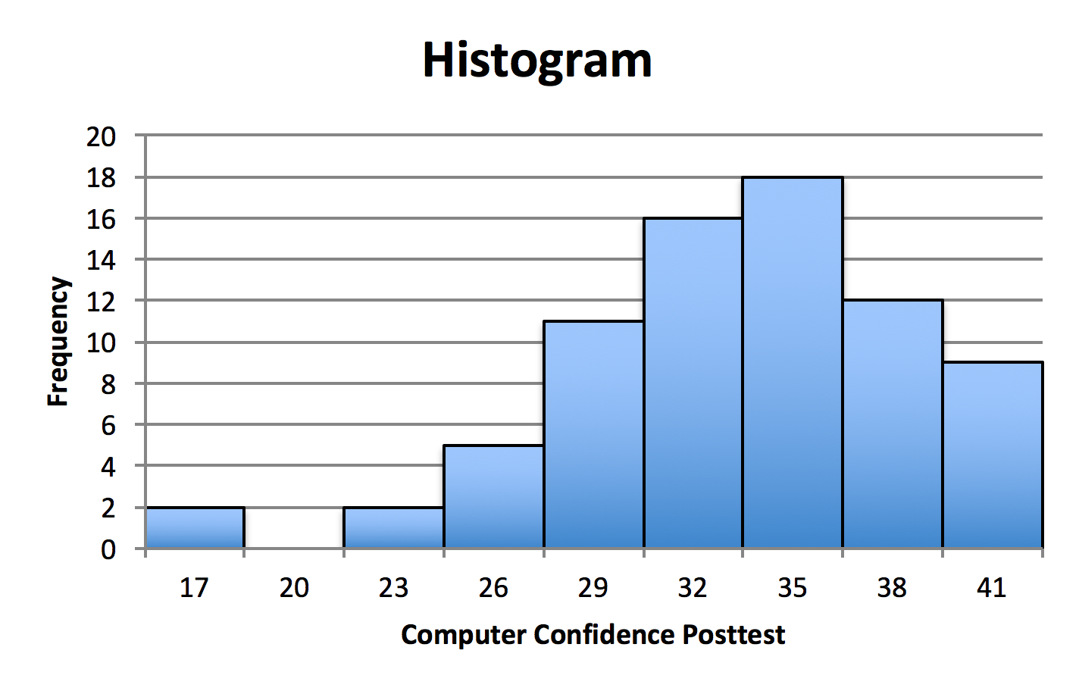
Histogram
A histogram is used to evaluate the shape of a distribution. It is a frequency curve that displays the shape of a univariate dataset (i.e., the distribution of a single variable).
The above histogram displays 9 bins (columns) that reflect the number (i.e., frequency) of values of computer confidence posttest in each bin. The bins consist of a constant interval that includes the minimum value (the first bin) to the maximum value (the last bin) of computer confidence posttest. Note that each bin has a constant bin width of 3.
Bin numbers in the above example represent the upper bound of each bin. For example, the first bin contains values between 14 and 17. There are 2 values in this bin. The second bin contains values higher than 17 up to and including 20. There are no values in this bin.
The above histogram displays a distribution that is asymmetric and negatively skewed with 2 negative outliers.

Slide 3
Histogram Construction
Divide the range of continuous data into equal-sized adjacent bins (classes or groups) along the x-axis
It is helpful to view these bins as fixed-interval containers that accumulate data that causes the bins to increase in height.
For each bin, a rectangle is constructed with an area proportional to the number of observations falling into that bin.
Bins are plotted on the x-axis and frequencies (the number of cases accumulated in each bin) are plotted on the y-axis. The y-axis ranges from 0 to the greatest number of cases deposited in any bin. The x-axis includes the entire data range.
The total area of the histogram is equal to the number of data points.

Slide 4
Creating a Histogram
First, determine the number of bins. There is no single rule regarding the number of bins displayed by a histogram. Different size bins often reveal different characteristics of a distribution, so experimentation with the number of bins is often useful. A popular formula for determining the minimum number of bins (k) in a distribution is given below.
However, histograms should have no fewer than 6 bins.
For example, is sample size is 49, the histogram should consist of 7 bins. If sample size is 25, the histogram should consist of 6 bins because the square root of 25 is less than 6 bins (the minimum number of bins).

Slide 5
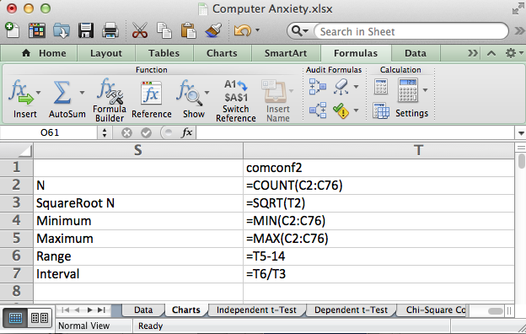
Calculate N, √ N, Minimum, Maximum, Range and Interval using the formulas shown in cells T2:T7.
Note: the variable (comconf2) is contained in cells C2 through C76.

Slide 6
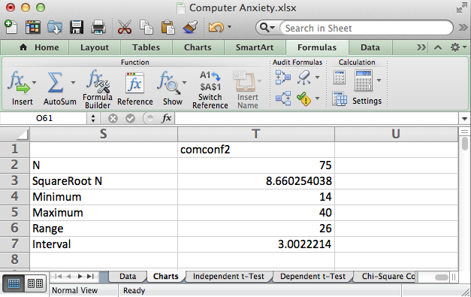
Round up the square root of N to identify the minimum number of bins. Round down the interval to identify maximum bin width. In this example the histogram will include 9 bins with a bin width of 3.

Slide 7
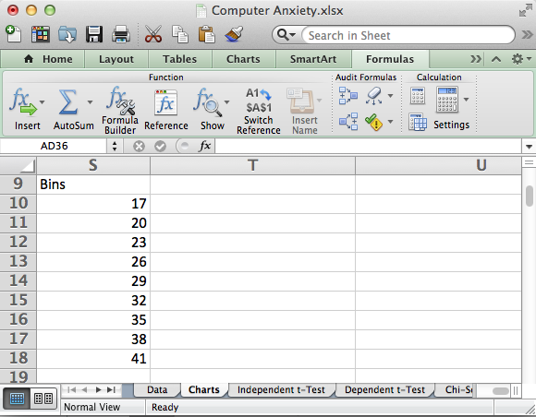
Create a label and set of bin upper boundary values for the histogram in cells S9:S18. Identify the first bin by adding the bin width to the minimum value (rounded). Then identify the upper boundary of subsequent bins by adding the bin width (3) to the previous upper bin boundary as shown on this worksheet.

Slide 8
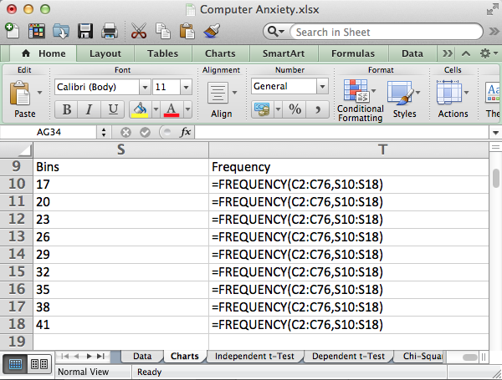
Next, enter “Frequency” as a label in cell T9. Then highlight cells T10:T18 and enter the array formula =FREQUENCY(C2:C76,S10:S18) and hit the CTRL-SHIFT-ENTER (or CTRL-SHIFT-RETURN) buttons at the same time.

Slide 9
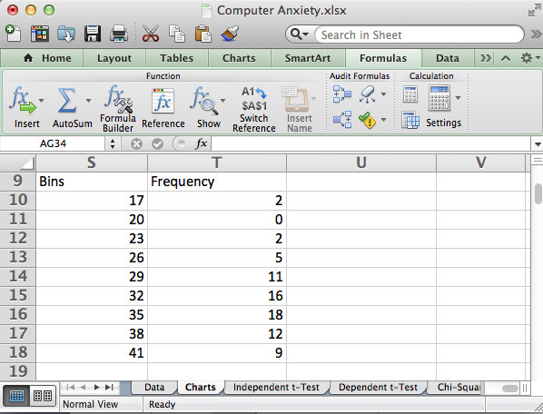
Excel produces a frequency table for the bins (class intervals). This table will be used to generate the histogram.

Slide 10
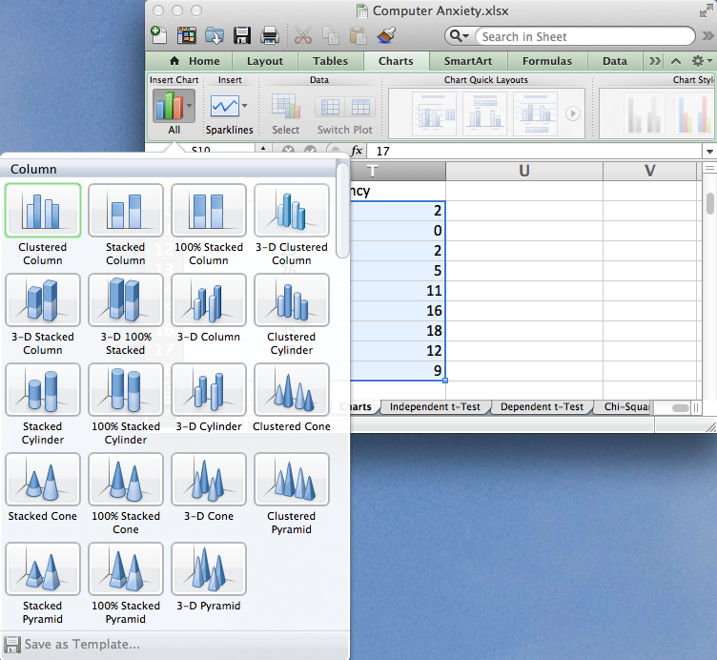
Highlight the range of values to plot, T10:T18.
Select the Charts tab. Select Clustered Column (the drop-down menu allows selection of a variety of column charts). The selected chart type appears on the workbook active sheet.

Slide 11
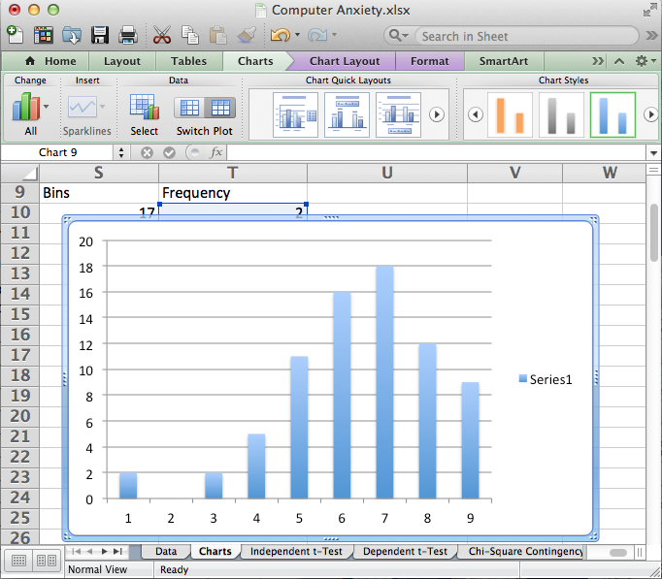
Highlight the legend (Series 1) and hit Delete. Double-click a column to open the Format Data Series dialog. Select Options and change gap width from 150% (default) to 0% Also, select Line and select black as the color so that columns are outlined in black. Click OK to close the dialog and make the change.

Slide 12
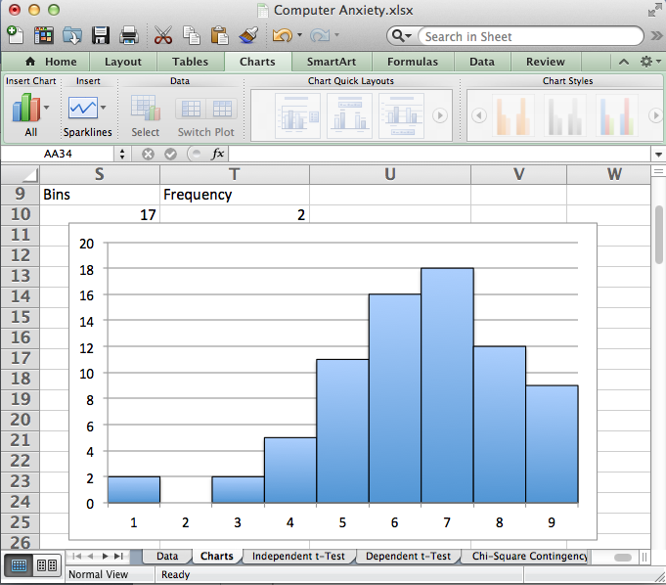
The result is a histogram that displays computer confidence posttest bin numbers on the x-axis. It reveals a non-symmetrical (i.e., asymmetrical), negatively-skewed shape for posttest computer confidence.
However, the x-axis does not reflect actual bin values.

Slide 13
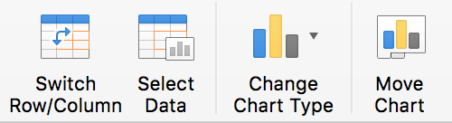
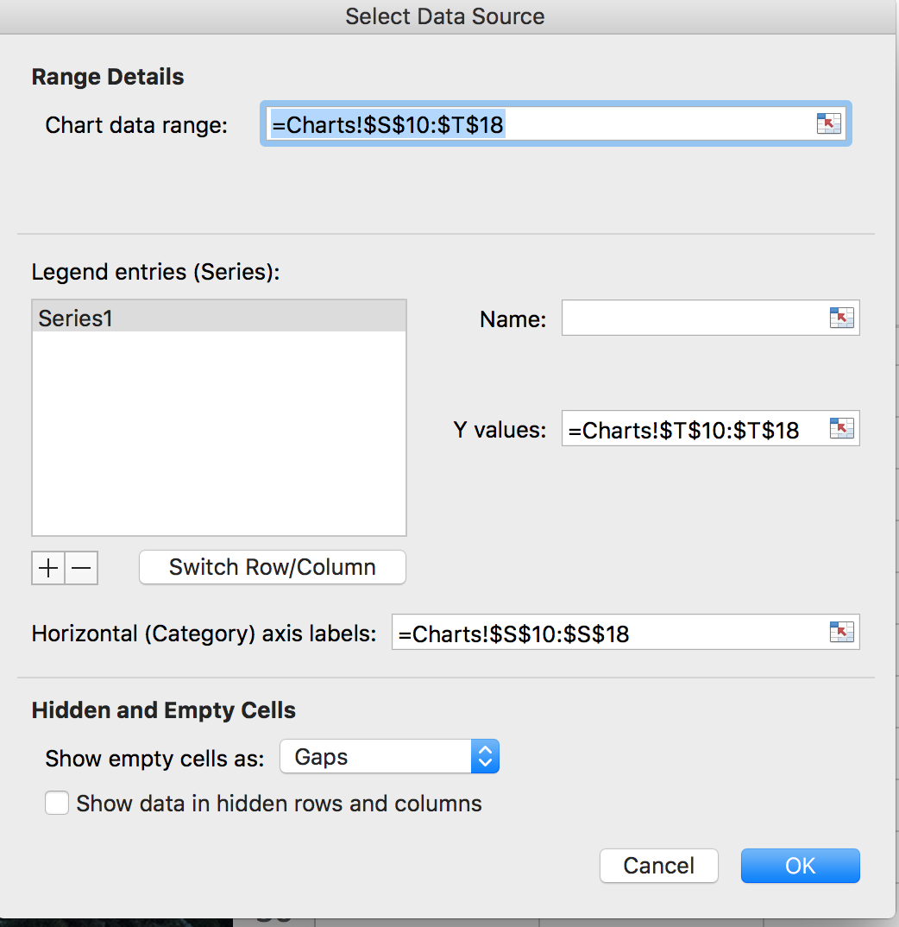
Click on the histogram to select it and click on the Select Data icon on the Chart Design tab to display the Select Data Source dialog. Change the Horizontal (Category) axis labels to reflect the cells that contain bin numbers (S10:S18 on the current worksheet).
Click OK to make the change.

Slide 14
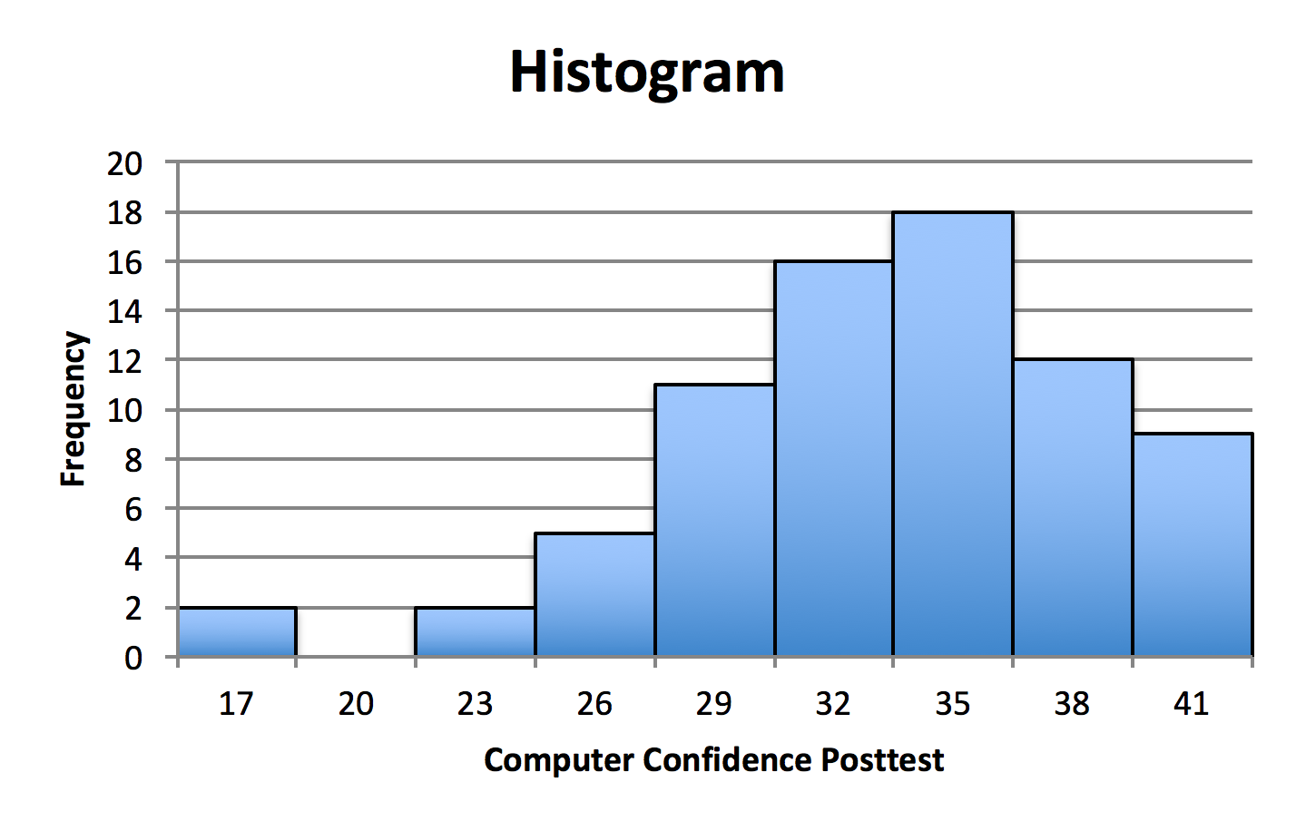
The result is a histogram that displays the bin numbers entered on the Excel worksheet. These bin numbers reflect the upper bound of each bin.
For example, the upper bound for the first bin is a computer confidence posttest score of 17. Since a bin width of 3 was used to create this histogram, the lower bound of this bin is 14. The histogram shows that there are two scores between 14 and 17.

Slide 15
Histograms
End of Presentation

